Slide 1

Welcome to Expedia Code Academy
JAVA 201

Slide 2
Pre-requisites:
An interest in learning some mind-bending CS concepts
Java installed on your machine (http://www.oracle.com/technetwork/java/javase/downloads/jdk8-downloads-2133151.html)
Intellij IDEA is installed on your machine (https://www.jetbrains.com/idea/download/)
You can enable the SDK by configuring IDEA settings and going to “Project”->”Project SDK”
To run your code, have the “main” function call your solution function. Then you have to right click on the class name and click “Run”
You have taken Java 101, or you have a knowledge of
Variables
If/else statements
Loops
Arrays
Function creation

Slide 3
Class Objectives:
In this class you will learn the following:
Create basic abstract data structures such as stacks and queues
Learn how to use recursion (see second bullet point for more details)
Quickly and efficiently search and sort through data.
You will use what you learned to complete the following project/projects:
Solve the Towers of Hanoi problem, calculate fibonacci numbers, sort data.

Slide 4
Review:
In your previous class you learned the basics of computer programming, and should be familiar with the following concepts:
Objects
Conditional statements (if/else, for/when loops)
Arrays

Slide 5
Review: Objects
An object is a collection of variables and functions wrapped up into an instance. These member variables and functions can be either “public” or “private”. “Public” portions can be accessed by external objects and programs, while “internal” portions can only be accessed from the object itself.
Ex:
Cat
- Fur (public)
- Legs (public)
- Tail (public)
- Stomach (private)
- purr() (public)
- sleep() (public)
- eat() (public)
- digest() (private)

Slide 6
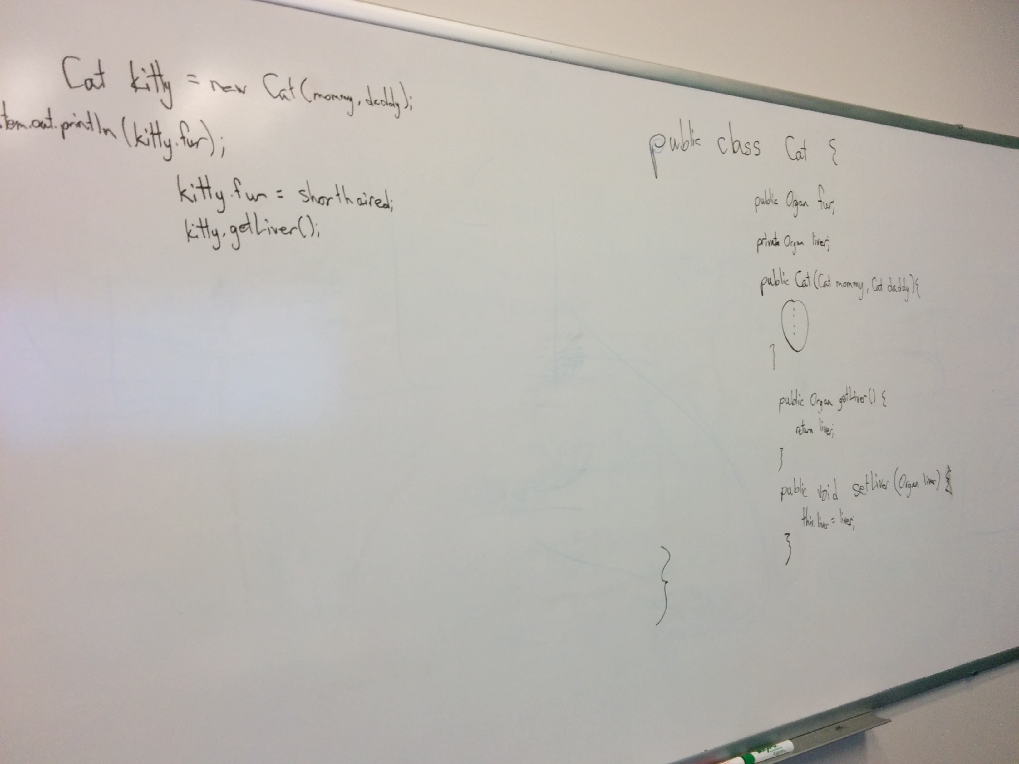
Review: Objects

Slide 7
Review: Arrays
An array is a series of numbers (or other variables) organized into a row, so we can move them around, copy them, and manipulate them in a set.
Ex: int a[10] = [1, 2, 3, 67, 4, 8, 9, 654, 8, 10]

Slide 8
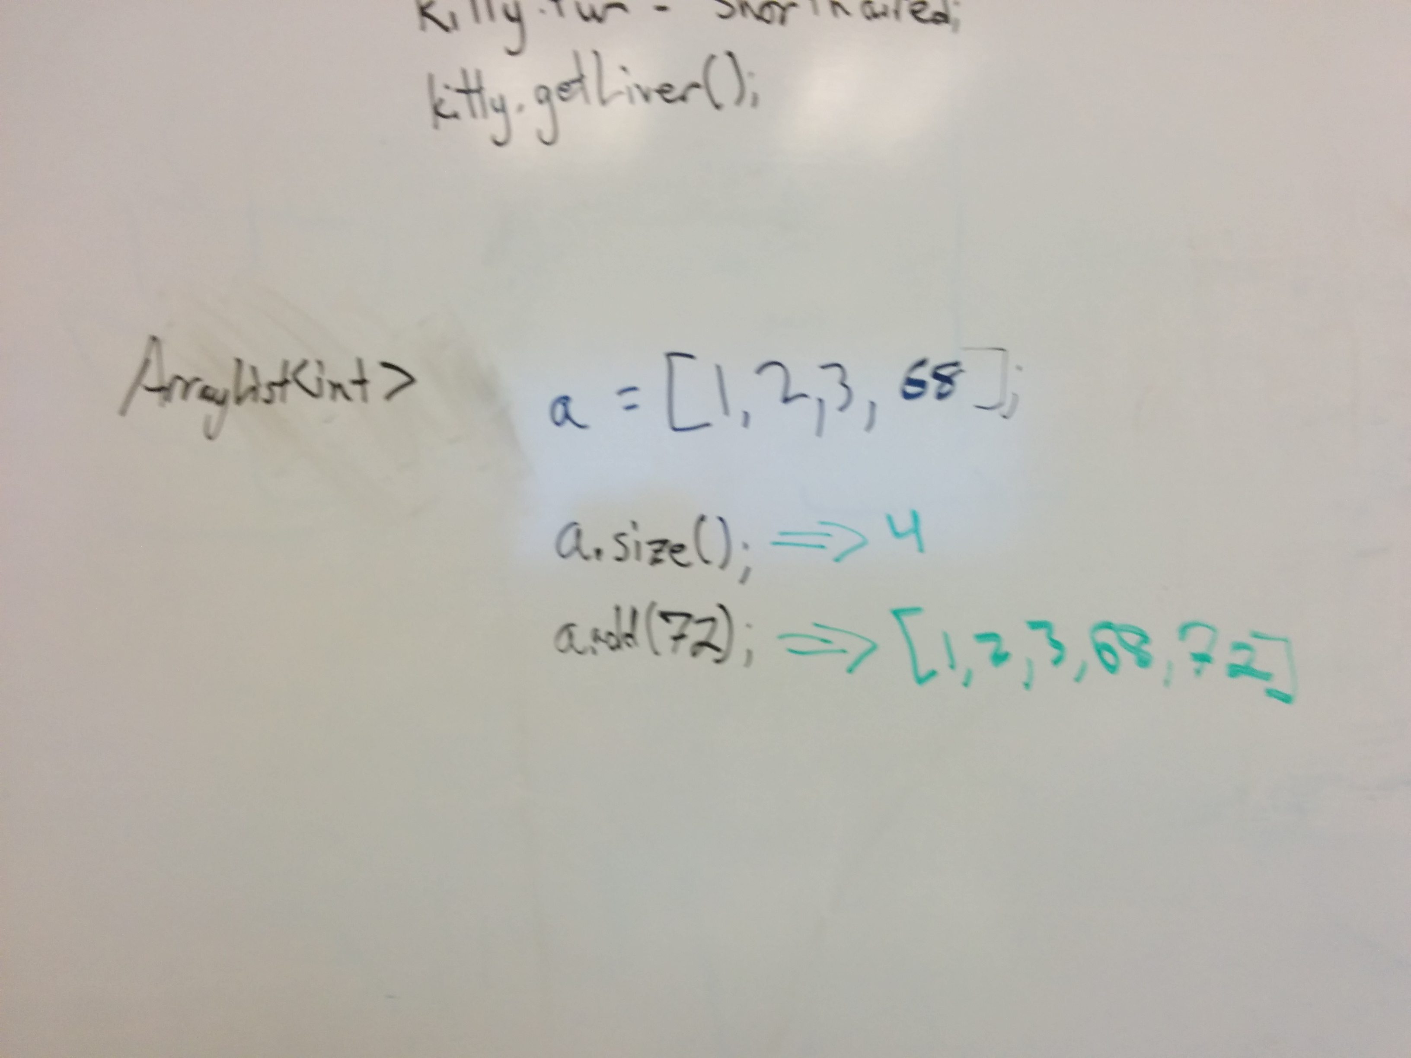
Review: Arrays

Slide 9
Review: Conditional Statements
A conditional statement is a statement that goes ”if x happens, then do y”. We can also tie this into loops, essentially saying “keep on doing y for as long as x remains true”. Loops are also useful if you want to do an action over a set of variables of unknown size (like in an array or in other data objects), without having to hard-code in how often an action has to be done
Loops:
For
While
Do/while
Conditionals:
- if/else
- switch

Slide 10
Lecture objectives:
What you will do in class today:
Create a simple linear search through an array and find a specified object.
Refine it a little bit into a binary search.
By the end of this class you will have the tools necessary to complete the following project/projects:
Traverse an array, reverse an array, manipulate elements in order, and come up with shortcuts and workarounds for making more efficient functions.

Slide 11
Linear Search:
Find and print out the position where the element “3” is located in the array below:
[1, 5, 6, 3, 33, 1, 5, 9, 809]

Slide 12
Linear Search:
To write a search function you must:
Define what you are looking for (a specific item, something that meets certain conditions, etc)
Come up with a way of going through the data (hint: try using a loop!)
Debugging tips:
Program taking too long/not outputting anything? Make sure that you have an exit condition for when the item is found.
How would you want your program to respond if the item that you’re looking for isn’t there?

Slide 13
Linear Search:
Now, how long will this search method take?
Are there ways that we can improve the runtime?

Slide 14
Binary search:
If we already have a sorted list, we could make searching for a number even easier:
Ex: [1, 4, 6, 7, 8, 9]

Slide 15
Binary search:
Shortcuts that we can do to a search when we go through a pre-sorted list.

Slide 16
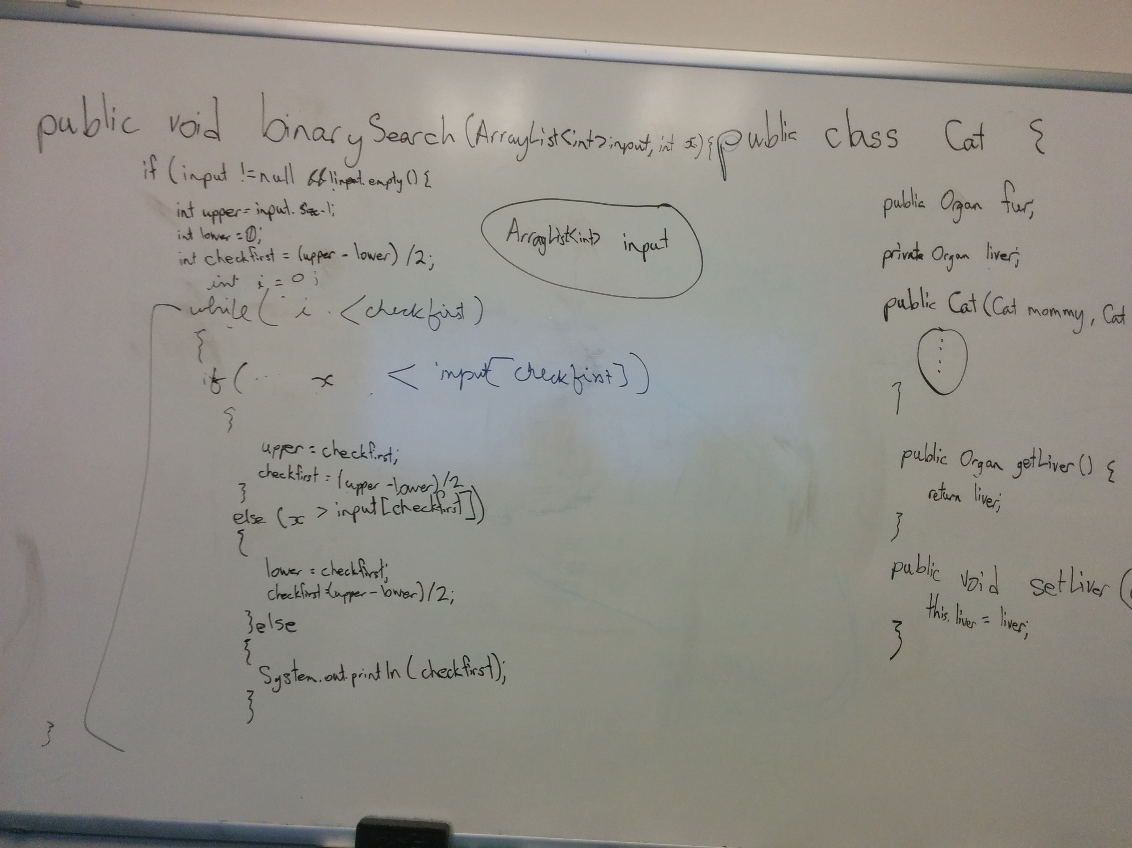
Binary search:

Slide 17
Homework:
Now take what you have learned and try:
Instead of finding elements in an array, I want you to try to manipulate them.
Try reversing the elements in an array
Try to figure out what sort of edge cases you may encounter, and see if you can solve them all
Ex: [1, 2, 3] becomes [3, 2, 1]
Submit your code by next class. Please submit your code to skoohgoli@expedia.com
Office hours: Tuesday, 12-1pm, Lower Lobby

